Slide 1
PROJECT VISION
Dead Car Restoration turns aging ICE cars into high-value EV assets
Flagship Build Thesis
Restore stranded vehicle value.
Create a premium EV conversion brand.
Scale from workshop to eastern India hub.
A Kolkata flagship conversion hub built on German technology, international experts, and a phased next-generation EV platform.
Planned as Kolkata's signature EV-conversion destination
Stakeholders Anish | Roland | Mark
Technology network Germany | Russia | South Korea
Dead Car Restoration
01

Slide 2
WHY NOW
India's aging fleet pressure creates a conversion window
Old and unfit vehicles are under rising policy pressure
Scrappage, testing, and fitness rules are pushing more owners to rethink end-of-life ICE vehicles.
What owners actually want
Rebuild.
Re-electrify.
Revalue.
Local pollution controls raise the pain of staying ICE
City-level clean-air action increases the economic and operational risk around older diesel and petrol platforms.
Owners need value recovery, not just disposal
Conversion is strongest where donor vehicles remain legally eligible and kits are type-approved for the make-model pathway.
A compliant EV conversion path can protect brand value, metal value, and vehicle identity where eligibility allows.
Dead Car Restoration
02
Notes:
Pressure is real, but not every old vehicle is automatically banned everywhere in India.
[Sources]
1. PIB, Vehicle Scrappage Policy, 2021, 08 Aug 2024: old, unfit and polluting vehicles are the policy focus; URL https://www.pib.gov.in/Pressreleaseshare.aspx?PRID=2042966&lang=2&reg=48
2. PIB, Notifications on Vehicle Scrapping Policy, 01 Dec 2021: framework includes RVSFs, automated testing stations, fees, and tax concessions; URL https://www.pib.gov.in/PressReleasePage.aspx?PRID=1776786&lang=2&reg=48

Slide 3
COMPLIANCE PATH
A compliant retrofit pathway can relaunch dead cars as electric vehicles
01
02
03
04
05
Screen donor vehicle
Match type-approved kit
Install through authorized center
Test and endorse registration
Deliver as EV asset
Use only kits that follow the notified retrofit and type-approval pathway.
Eligible conversion categories are framed under AIS-123 pathways for retrofit and pure-electric conversion.
Registration endorsement and local authority processes matter as much as workshop quality.
Three non-negotiables
Eligible donor vehicle condition and category fit.
Type-approved conversion kit and authorized installer.
Registration endorsement and local authority compliance.
Retrofit is a regulated industrial process, not a cosmetic garage modification.
Dead Car Restoration
03
Notes:
The deck deliberately frames retrofit as a compliant pathway rather than a casual conversion service.
[Sources]
1. MoRTH Notification G.S.R. 748(E) dated 07 Aug 2018: pure electric conversion with Pure Electric System Kit is described against AIS-123 Part 3 and relevant categories; URL https://morth.nic.in/sites/default/files/notifications_document/Notification_no_G_S_R_748E_dated_07_08_2018_regarding_Retrofitment_of_Hybrid_Electric_Kit_or_Electric_System%C2%A0_0.pdf
2. PIB, Government pushes Electrical Mobility on roads, 11 Feb 2019: government stated retrofitment and type-approval procedures had been notified for EV promotion; URL https://www.pib.gov.in/Pressreleaseshare.aspx?PRID=1563841&lang=2&reg=48

Slide 4
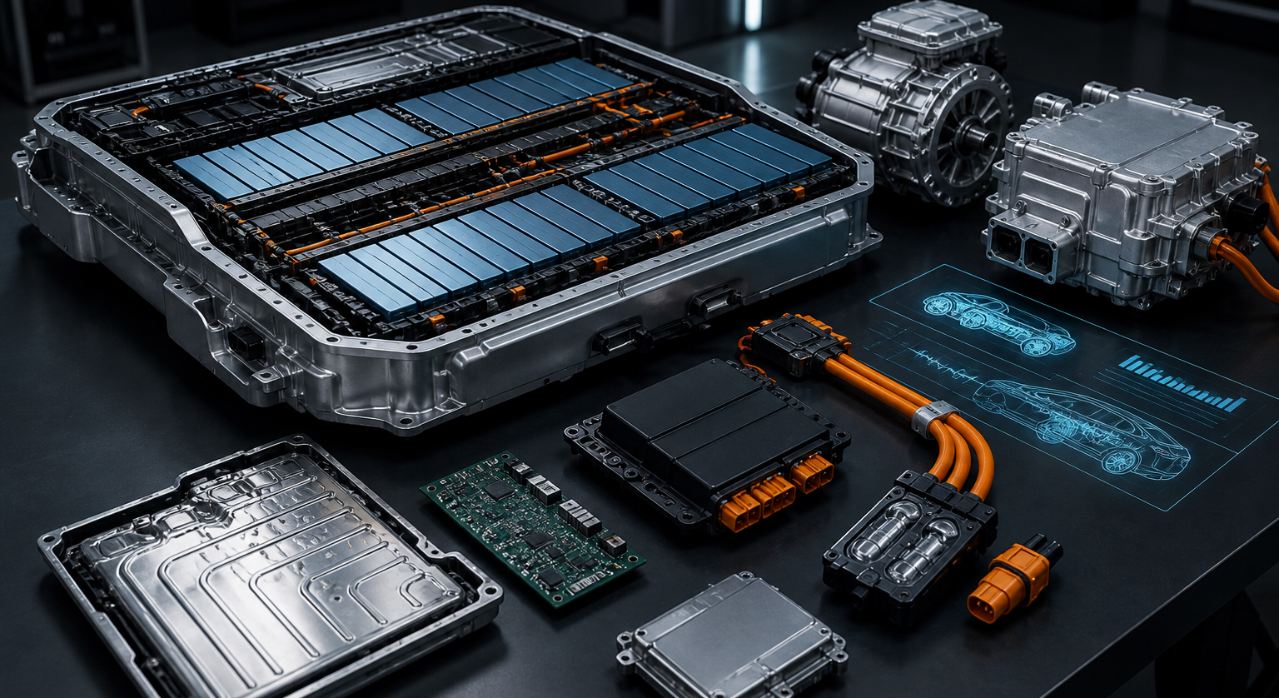
TECHNOLOGY STACK
The business starts with strong LFP conversions and expands into a premium roadmap
Show the current hardware credibility first, then frame next-generation layers as controlled upgrades.
Current conversion core
LFP chemistry for repeatable durability, thermal stability, and field service.
Modular retrofit packaging with telematics-ready control architecture.
Mechanical integration that makes restored vehicles feel engineered, not improvised.
Premium roadmap layers
Solid-state pathways for halo builds and faster premium charging.
OTA diagnostics, ADAS-ready packages, and frugal electronics upgrades.
800V or 900V architecture ambition for showcase and export-grade platforms.
LFP BASELINE
Roadmap layers are framed as future upgrade paths, not as universal day-one claims across every build.
Dead Car Restoration
04
Notes:
Visual asset on this slide was generated in-house to represent the EV technology stack in a proposal-ready format.
Technology references such as solid-state, OTA, ADAS, frugal architecture, and 800V or 900V systems are project-provided roadmap directions rather than claims of universal current deployment.

Slide 5
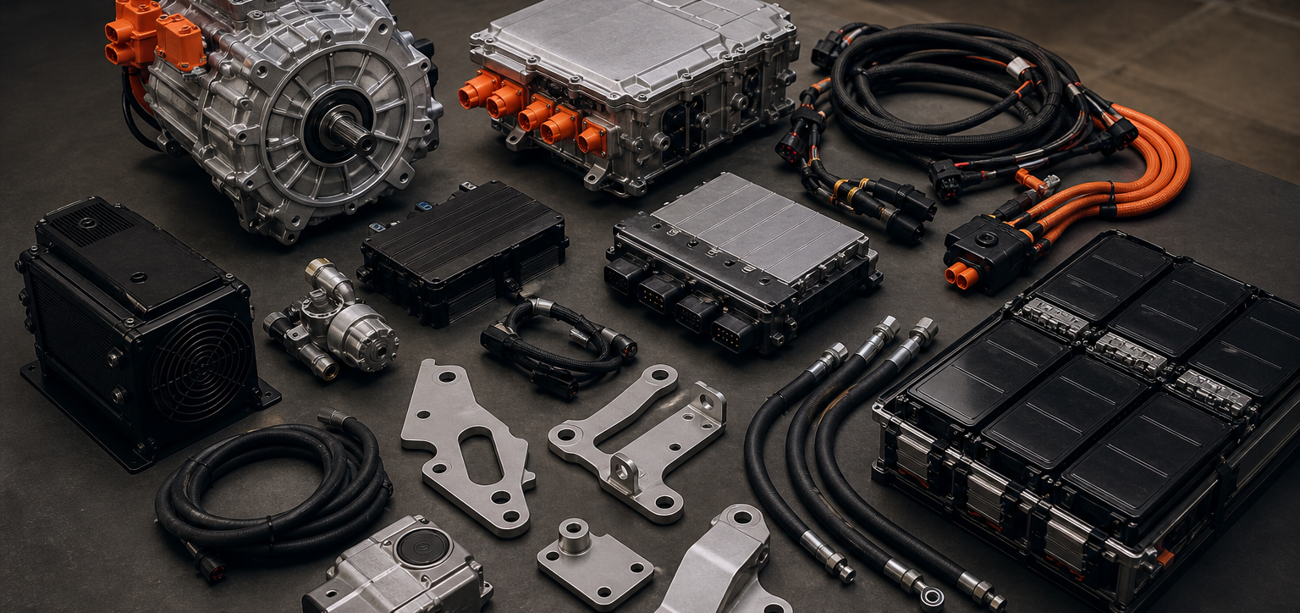
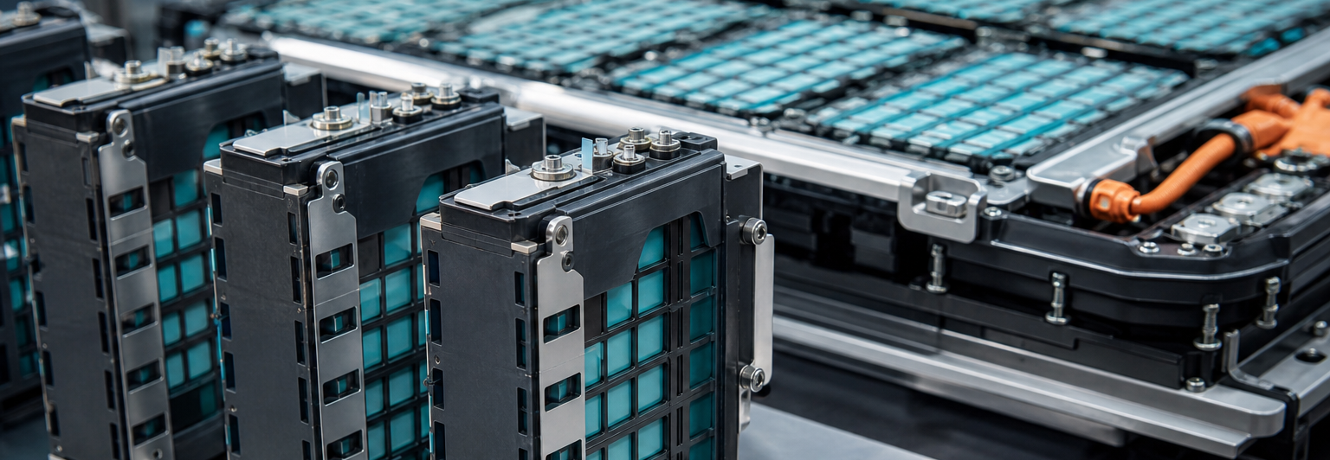
CONVERSION SYSTEM
DCR starts with a real retrofit kit today, then layers premium EV capability over time
Build logic
Production intent begins with modular LFP battery packs that can be serviced and scaled across vehicle formats.
Conversion architecture is designed to accept calibration, telematics, thermal, and charging upgrades without rebuilding the entire car.
Roadmap layers such as solid-state cells, OTA ecosystems, ADAS, frugal architecture, and 800V or 900V systems are positioned as premium future packages.
Core hardware: motor, inverter, BMS, onboard charging, HV harnesses, controls, and cooling interfaces.
The message to buyers and regulators is simple: start with a robust conversion package now, then earn the right to introduce advanced premium layers.
Dead Car Restoration
05
Notes:
Visual assets on this slide were generated in-house for this deck to illustrate the intended conversion-kit and battery-pack presentation style.
Technology references such as LFP, solid-state, OTA, ADAS, frugal architecture, and 800V or 900V systems are project-provided roadmap inputs, not presented here as already deployed across all builds.

Slide 6
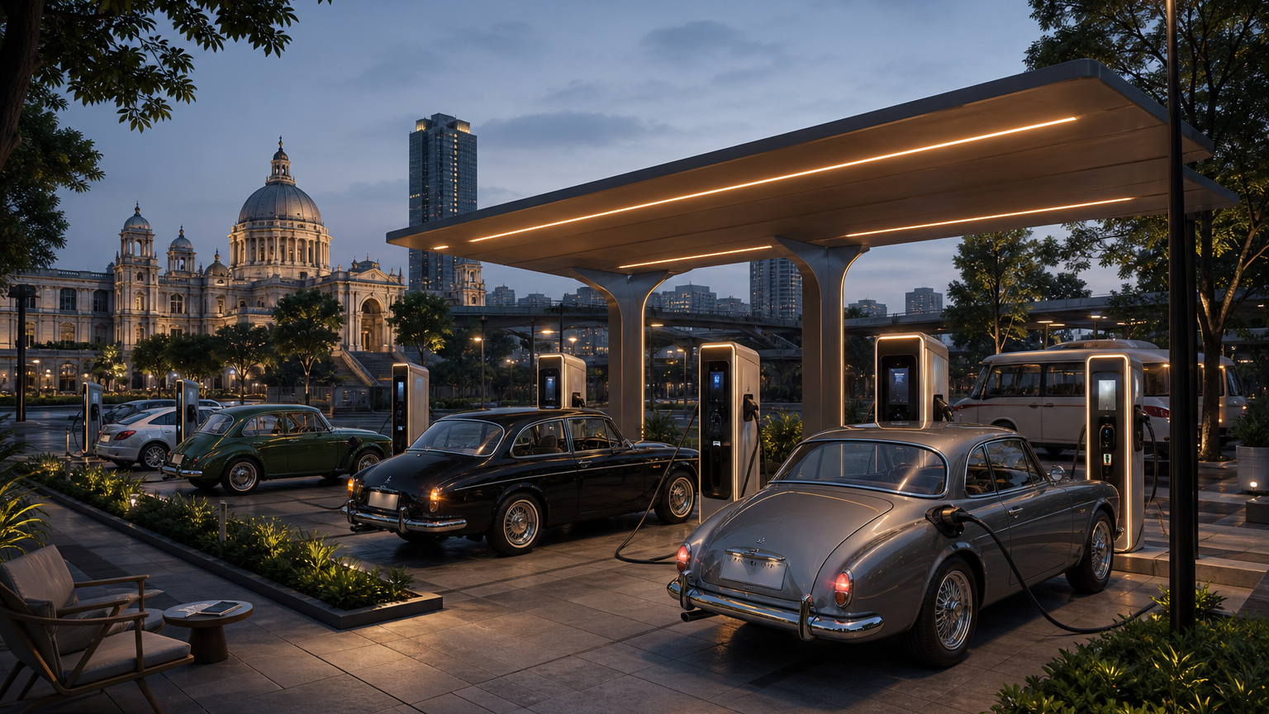
CHARGING ACCESS
DCR charging stations make converted vehicles practical, visible, and easy to adopt
Flagship public nodes
Visible DCR-branded fast-charging plazas near high-traffic Kolkata corridors make restored EVs feel mainstream, not experimental.
The charging layer is not an afterthought. It is the confidence system that helps customers say yes to conversion.
Fleet and partner charging
Workshop, depot, parking, hospitality, and fleet partnerships give commercial users dependable operating access beyond the core factory.
Owner support
DCR can help owners navigate home charging, utility coordination, service planning, and battery-health monitoring after delivery.
This operating layer aligns with West Bengal's EV charging push, where WBSEDCL publicly positions itself as the single-point contact for charging infrastructure.
Dead Car Restoration
06
Notes:
[Sources]
1. West Bengal State Electricity Distribution Company Limited, Awareness about EV and EV charging in West Bengal; URL https://www.wbsedcl.in/irj/go/km/docs/internet/new_website/EV.html
2. Department of Power, Government of West Bengal policy page lists Electric Vehicle Policy 2021; URL https://power.wb.gov.in/policy/
The charging-station proposal is a project strategy layer. It is not presented as an already operational DCR network.

Slide 7
KOLKATA THESIS
Kolkata gives DCR logistics visibility, policy relevance, and a public stage
KOLKATA
1
Port and logistics access can shorten the path for imported components, tooling, and specialized EV subsystems.
Port-linked supply.
Industrial execution.
A showcase market for the east.
2
A large urban vehicle base gives DCR a visible intake market for donor cars, enthusiast builds, and early commercial conversion pilots.
3
The state's transport priorities already reference lower-carbon transport, green infrastructure, and private investment participation.
Flagship hub concept for the eastern corridor
4
Kolkata can become the brand theater where restoration, charging, training, and service all appear in one city-scale mobility story.
Project ambition: build India's most visible integrated EV conversion hub in Kolkata.
Dead Car Restoration
07
Notes:
[Sources]
1. Transport Department, Government of West Bengal, Future Plans; URL https://transport.wb.gov.in/about-us/future-plans/
2. Transport Department, Government of West Bengal, Investor Relations; URL https://transport.wb.gov.in/about-us/investor-relations/
3. Department of Power, Government of West Bengal policy page lists Electric Vehicle Policy 2021; URL https://power.wb.gov.in/policy/
This slide frames Kolkata as the proposed flagship location. It does not claim an existing government approval.

Slide 8
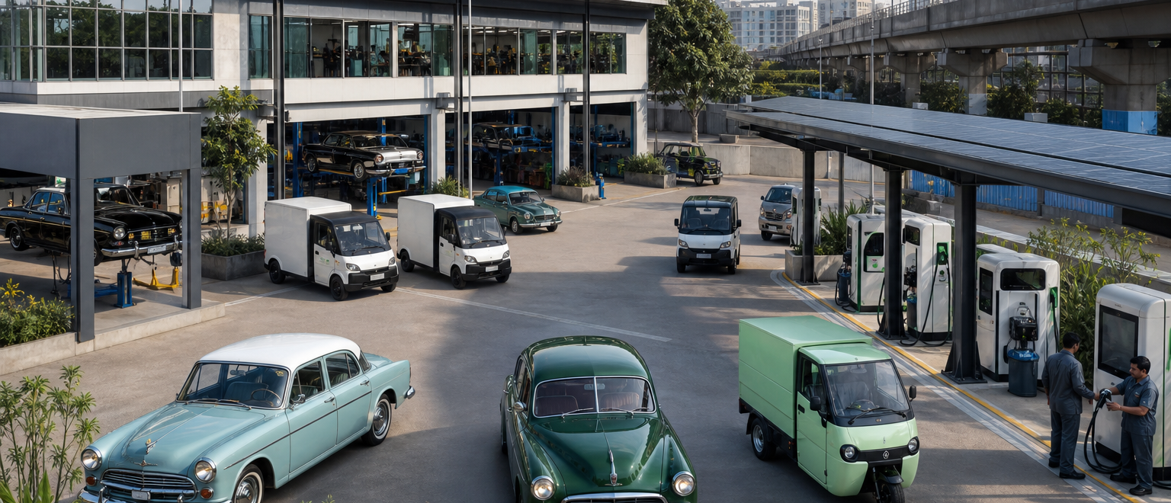
PROPOSAL NOTE
Proposal note for Kolkata Government and state transport bodies
Position Dead Car Restoration as a green-mobility, restoration, training, and charging project that helps Kolkata visibly lead the next phase of practical urban transition.
Why it fits the city agenda
What DCR requests
It creates a visible low-carbon mobility story without waiting for an entirely new vehicle base to replace existing cars.
It combines industrial work, charging access, and skills development in a way that can live inside a broader green infrastructure narrative.
It gives Kolkata a signature project that restores legacy vehicles emotionally while moving them toward cleaner road use.
1
Industrial land or redevelopment-compatible site support for the flagship hub and demonstration yard.
2
Fast-track alignment with transport, utility, and urban authorities for lawful conversion, inspection, and charging access.
3
Permission to pilot public-facing restoration showcases, charging nodes, and first fleet demonstrations in Kolkata.
4
A structured PPP dialogue so the project can plug into the state's transport-infrastructure execution ecosystem.
The proposal is framed to match West Bengal's published emphasis on private participation, green infrastructure, and transport-hub development.
Dead Car Restoration
08
Notes:
[Sources]
1. Transport Department, Government of West Bengal, Investor Relations; URL https://transport.wb.gov.in/about-us/investor-relations/
2. Transport Department, Government of West Bengal, Future Plans; URL https://transport.wb.gov.in/about-us/future-plans/
3. Transport Department, Government of West Bengal, WBTIDC; URL https://transport.wb.gov.in/about-us/department-at-a-glance/corporation/wbtidc/
Visual asset on this slide was generated in-house to represent a proposal-ready EV conversion and charging hub concept.
This slide is a proposal note for consideration, not a statement of government endorsement.

Slide 9
OPERATING MODEL
The hub is designed as factory, compliance desk, and service engine in one system
01
02
03
Intake and diagnostics
Strip and restoration
Powertrain conversion
04
05
06
Battery integration
Calibration and validation
Delivery and lifetime support
Support engines
Training academy | spares cell | battery service | OTA support | compliance desk
Dead Car Restoration
09

Slide 10
GOVERNMENT UPSIDE
Kolkata gains fiscal activity, jobs, and public goodwill from the DCR factory
The value case should be read as a set of strategic gain channels for government, not as audited revenue projections.
Revenue activity
Tax and fee base
Jobs and skills
Public support
A flagship plant drives vendor spending, site development, service demand, and industrial transactions around the hub.
Legal restoration, charging operations, registrations, electricity demand, and commercial activity can widen the formal collection base over time.
The project creates work across fabrication, diagnostics, software support, battery care, charging operations, and technician training.
Owners get an emotional win: beloved old cars can return to roads in a cleaner, compliant, and future-facing form.
A visible restoration project can convert public nostalgia into support for cleaner mobility rather than making the transition feel like pure loss.
Dead Car Restoration
10
Notes:
[Sources]
1. Transport Department, Government of West Bengal, Investor Relations; URL https://transport.wb.gov.in/about-us/investor-relations/
2. Transport Department, Government of West Bengal, WBTIDC; URL https://transport.wb.gov.in/about-us/department-at-a-glance/corporation/wbtidc/
3. West Bengal State Electricity Distribution Company Limited, Awareness about EV and EV charging in West Bengal; URL https://www.wbsedcl.in/irj/go/km/docs/internet/new_website/EV.html
Revenue, tax, and public-support items on this slide are directional strategic value channels for government consideration and are not presented as audited forecasts.

Slide 11
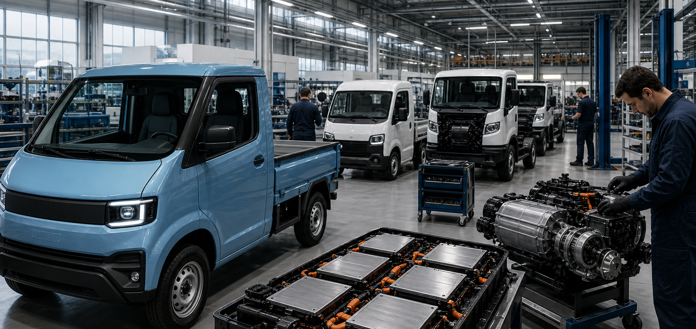
INVESTMENT OPPORTUNITY
DCR can become a conversion-order base for pickups and small industrial trucks
The Kolkata factory can pitch pilot conversion batches, charging support, and lifecycle service to commercial-vehicle players that want electric last-mile and utility transport options.
Target use case: pickups, compact cargo vehicles, utility vans, and smaller industrial transport fleets.
Factory offer
Illustrative target OEMs
Pilot conversion lots for pickups, compact cargo vehicles, and smaller industrial transport fleets.
Payload, charging, and route-use validation for city, depot, utility, and factory movement use cases.
Long-tail service, battery care, telematics, and infrastructure support from one operating base.
Tata Motors
Ashok Leyland
BharatBenz
Mahindra & Mahindra
Eicher Trucks
Illustrative OEM and fleet channels only, not confirmed commitments or signed partnerships.
Dead Car Restoration
11
Notes:
[Sources]
1. Transport Department, Government of West Bengal, Investor Relations; URL https://transport.wb.gov.in/about-us/investor-relations/
2. Transport Department, Government of West Bengal, WBTIDC; URL https://transport.wb.gov.in/about-us/department-at-a-glance/corporation/wbtidc/
Visual asset on this slide was generated in-house to represent compact electric truck conversion and factory-readiness.
Company names on this slide are sponsor-provided illustrative target counterparties for future order discussions. The slide does not claim active mandates, purchase orders, or signed partnerships.

Slide 12
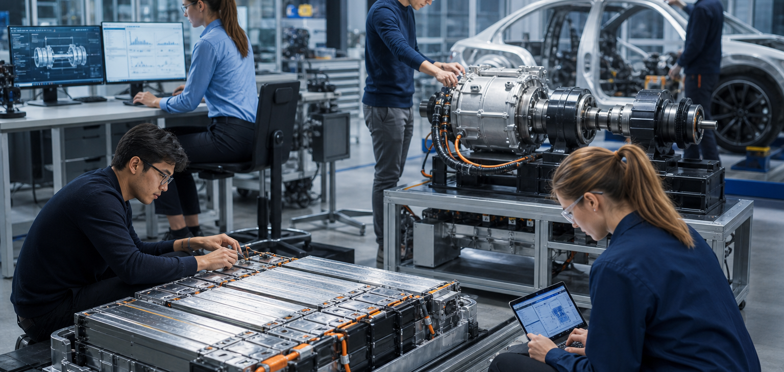
YOUTH AND RESEARCH
The Kolkata hub can create youth jobs and grow into an EV research base
Start as a factory and training engine, then mature into a practical lab for batteries, retrofit systems, diagnostics, and small-commercial EV architecture.
Youth jobs
Training pipeline
Research hub
Workshop, assembly, testing, charging, logistics, and service roles can create immediate hands-on employment for local young talent.
The site can train technicians for EV conversion, battery care, calibration, and compliance support instead of importing every skill from outside.
Over time the plant can become a test bed for frugal EV architecture, software, thermal systems, and next-generation retrofit packages.
The research-hub outcome is presented as a medium-term ambition built on training, field data, and operating experience from the factory.
Dead Car Restoration
12
Notes:
[Sources]
1. Transport Department, Government of West Bengal, Future Plans; URL https://transport.wb.gov.in/about-us/future-plans/
2. Transport Department, Government of West Bengal, Investor Relations; URL https://transport.wb.gov.in/about-us/investor-relations/
Visual asset on this slide was generated in-house to represent youth training and EV research capability.
Employment and research-hub outcomes are presented as project-development pathways, not as already established institutions or guaranteed job counts.

Slide 13
REVENUE MODEL
Revenue stretches beyond conversion jobs into energy, upgrades, and service continuity
01
02
03
04
Premium restoration
Fleet conversion
Charging and energy
Lifecycle services
High-identity passenger builds that bring old cars back as aspirational EV products.
Commercial and institutional programs that turn utilization pressure into electrified operating assets.
Charging access, energy partnerships, and site-linked service packages create recurring utilization-based revenue.
Service contracts, software updates, diagnostics, battery care, and refurbishment work extend customer value.
The strongest model is conversion plus charging plus upgrades plus recurring service, not workshop-only income.
Dead Car Restoration
13

Slide 14
CLOSING POSITION
Dead Car Restoration is built as a signature industrial story, not a one-off workshop
German technology
Engineering-led restoration discipline and product credibility.
Russia and South Korea expert network
Lead with compliant LFP conversions. Build the Kolkata flagship. Add charging confidence. Then scale into premium software and performance layers.
Specialized battery, systems, and platform expertise for the build roadmap.
Kolkata flagship build-out
A bold physical hub that makes the venture visible, scalable, and category-defining.
Immediate asks
Stakeholders
Secure hub site | align government partners | lock homologation partners | launch first pilot fleets and chargers
Anish | Roland | Mark
Dead Car Restoration
14

